Slide 1


SIREN
Kraken RoboTradeAssistant

Slide 2
The future is Automation
ChatBot = perfect example of Automation
Artificial intelligence will displace 40% of jobs worldwide within 15 years
1.4 billion people use messaging apps and are willing to talk to chatbots
Chatbots saw a 92% use increase since 2019, making it the brand communication channel with the largest growth
Growing willingness to engage with chatbots in a variety of ways more than doubling from 2019 to 2020
87.2% of consumers rate their typical chatbot experience as within the range of neutral to positive

Slide 3


Low Premiums
Low exchange fees
Sophisticated trading platform
Greater selection of Alt Coins
Higher interest in staking rewards
High Premiums
High exchange fees
Potential delayed transaction times
Limited selection of Alt Coins
COINBASE
KRAKEN

Slide 4
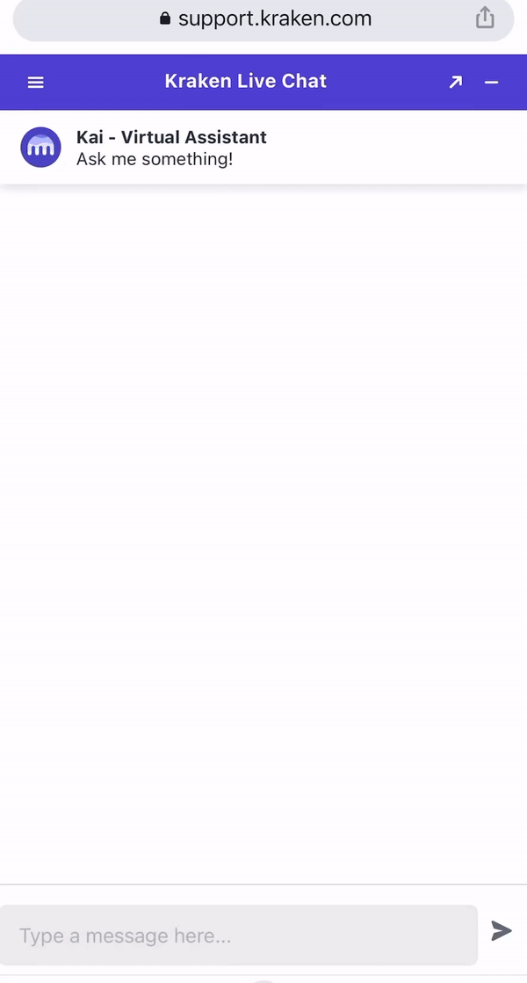
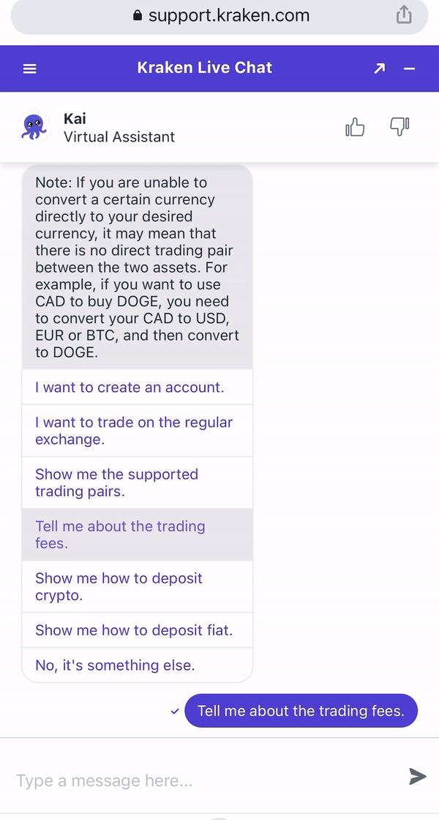

Slide 5
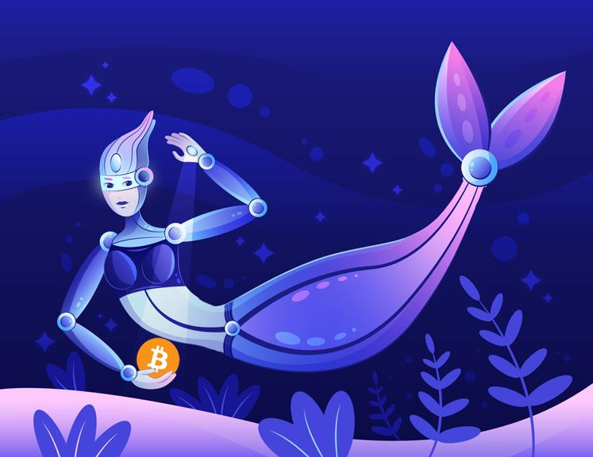

Kraken RoboTradeAssistant Siren

Slide 6
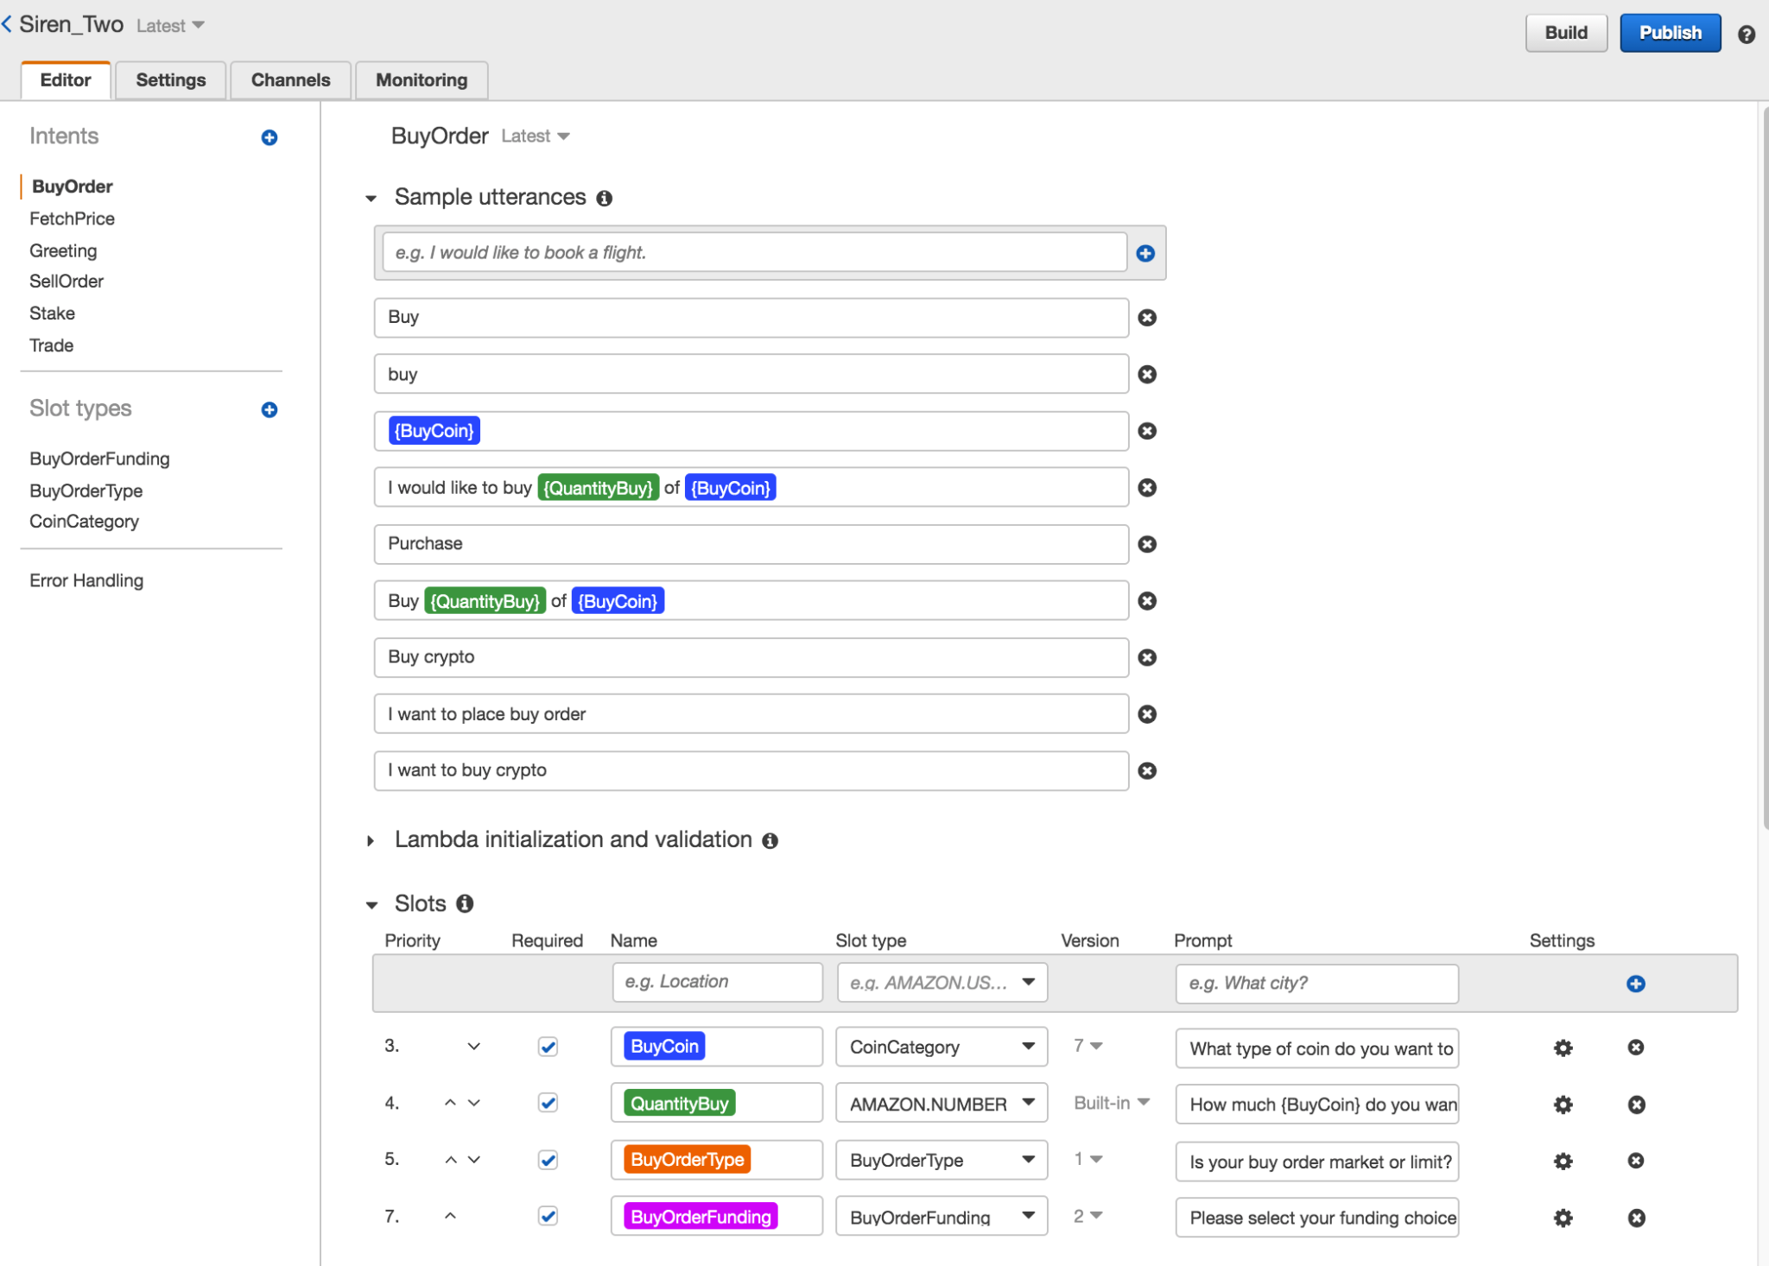
Siren Prototype
AWS Lex + AWS Lambda
Lex: 6 Intents- Greeting, Trade, BuyOrder, SellOrder, Stake and FetchPrice
1- 5 slots (each)
Prompts w/ response cards user’s utterances -----> Siren’s execution
Lambda (Python) allows to implement custom business logic (ex. API call to Kraken fetching current market price)
INTENT
SLOT
SLOT
SLOT TYPE
SLOT TYPE
SLOT TYPE

Slide 7
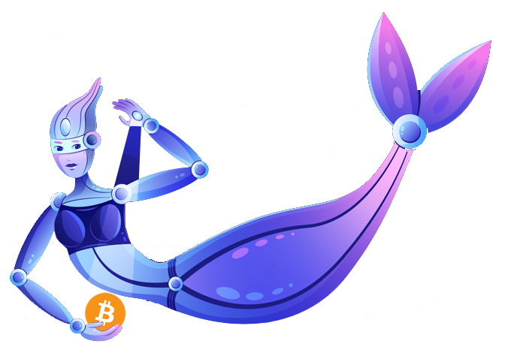
BUY COIN
BUY ORDER
BITCOIN
ETHEREUM
QUANTITY BUY
BUY ORDER TYPE
RIPPLE
MARKET
BUY ORDER FUNDING
CARDANO
LIMIT
FILECOIN
USD
POLKADOT
BITCOIN
BUY CONFIRMATION TOTAL
LITECOIN
ETHEREUM
CHAINLINK

Slide 8
SELL COIN
SELL ORDER
BITCOIN
ETHEREUM
QUANTITY SELL
SELL ORDER TYPE
RIPPLE
MARKET
CARDANO
SELL ORDER EXCHANGE
LIMIT
FILECOIN
STOP LOSS
USD
POLKADOT
BITCOIN
SELL CONFIRMATION TOTAL
LITECOIN
CHAINLINK
ETHEREUM

Slide 9
STAKE ORDER
STAKE COIN
ETH
NOTE: Proceed through buy order flow chart if client has no ownership of
stakable options.
QUANTITY STAKED
STAKE CONFIRMATION
DOT

Slide 10
FETCH PRICE
REAL TIME COIN PRICE
BITCOIN
ETHEREUM
RIPPLE
CARDANO
NOTE: Linked token to exchange.
DISPLAY PRICE
FILECOIN
POLKADOT
LITECOIN
CHAINLINK

Slide 11
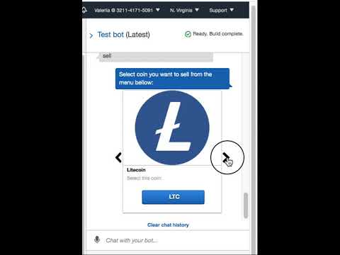

Slide 12
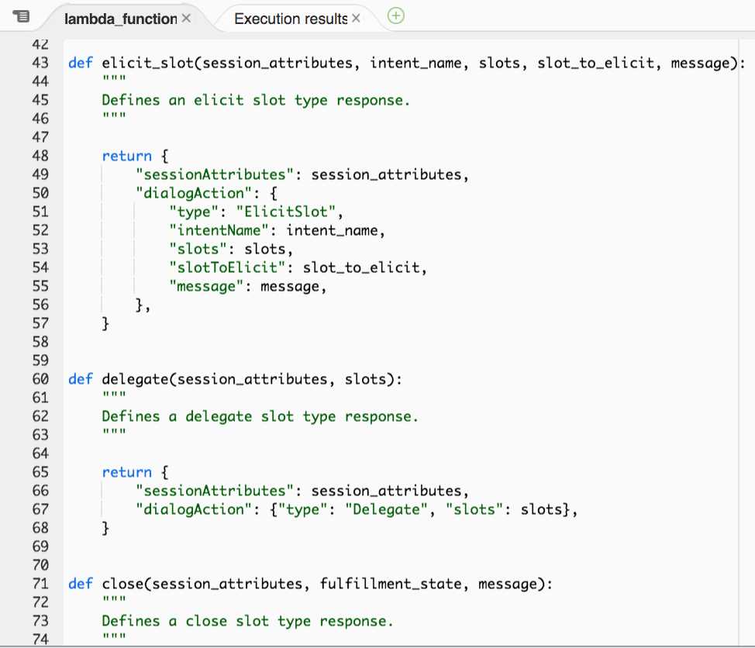
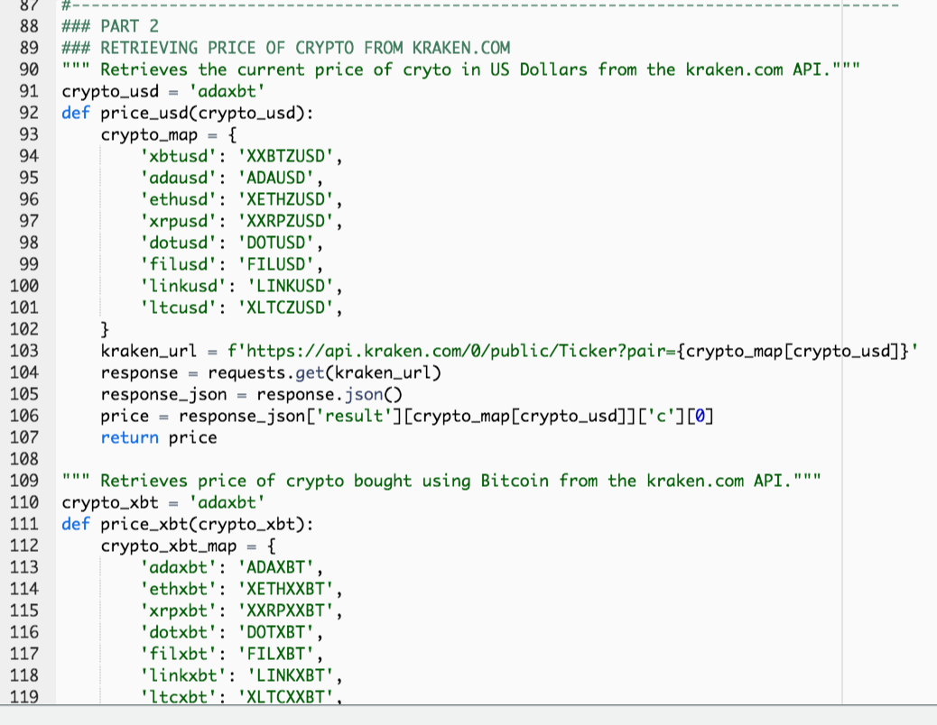
Backend Coding

Slide 13
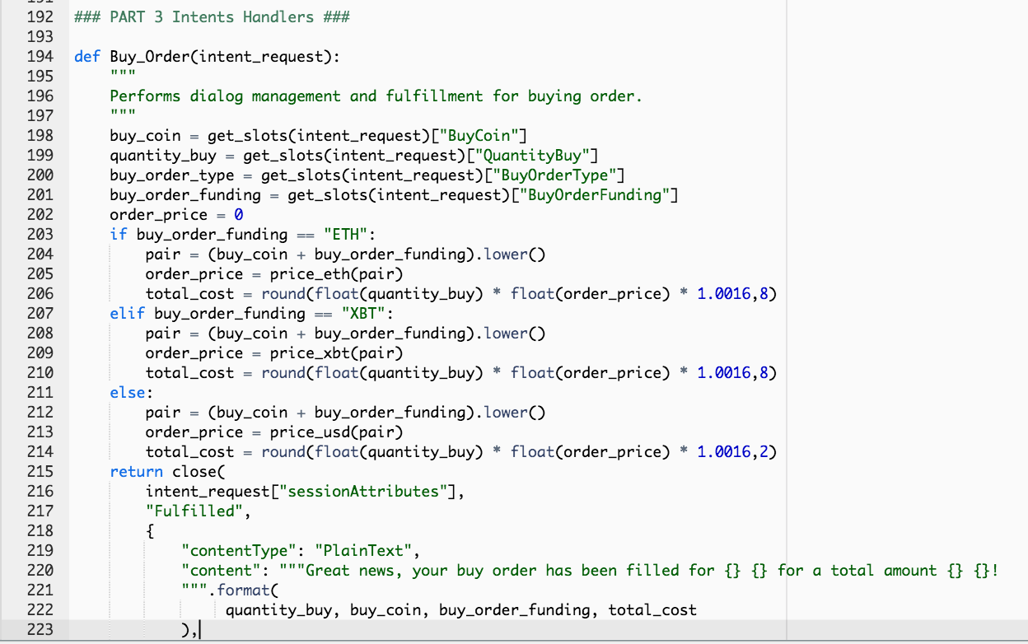
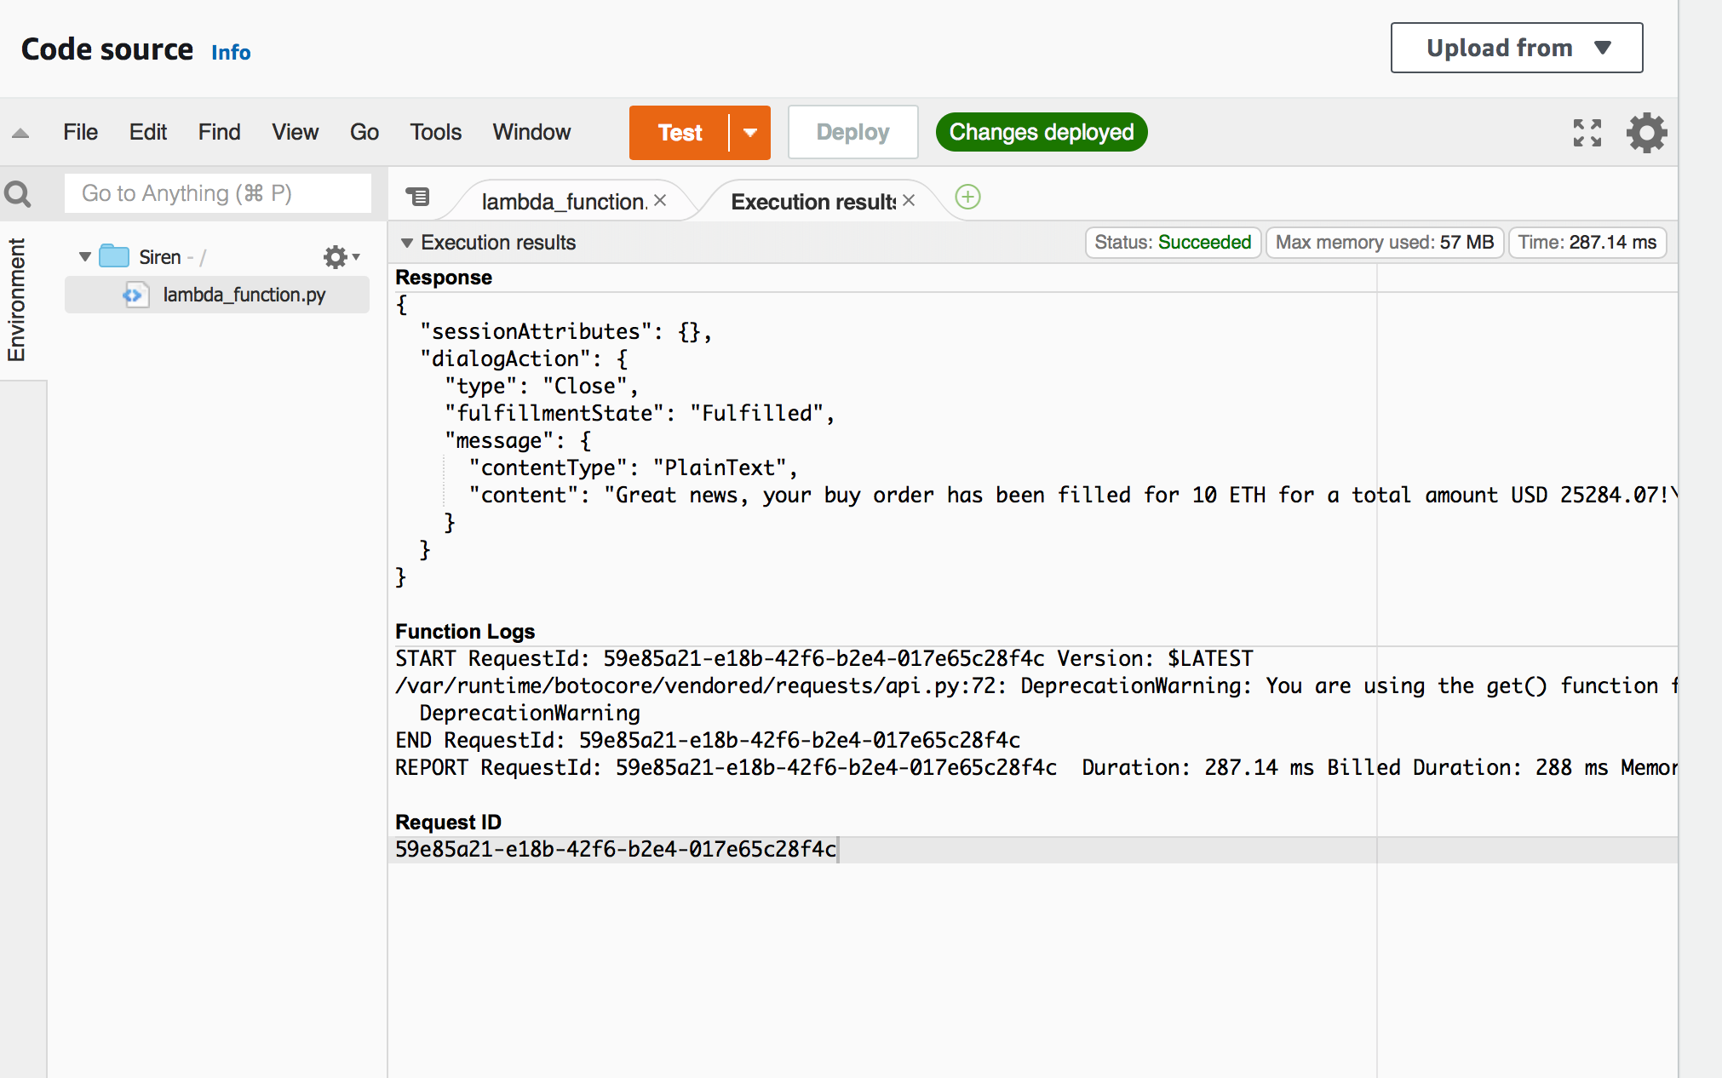
Backend Coding

Slide 14
Prospective growth of Siren
Immediate - NLP + Machine Learning = intuitive and advanced Siren
Level Up 1- Execute more complex trades, stop loss and take profit orders etc
Level Up 2- Make Siren DeFi ready for Uniswap and Polkadex (user navigation)
Defi efficiency to spot and execute on the exchange with the lowest exchange rates
Spots trade arbitrage opportunity between time zones and exchanges
Level Up 3 - Siren AI exchange integrated trading bot for client subscription conducting all work
Data collection over time will inform Siren common trade trends, sentiment, and when to execute an order
Data collection allows Siren to identify type of market and adjust trading strategy (i.e. bull, bear, wave market)
While Siren cannot predict the news, recognizing sentiment, it will adjust to market volatility

Slide 15

THANK YOU

Slide 18
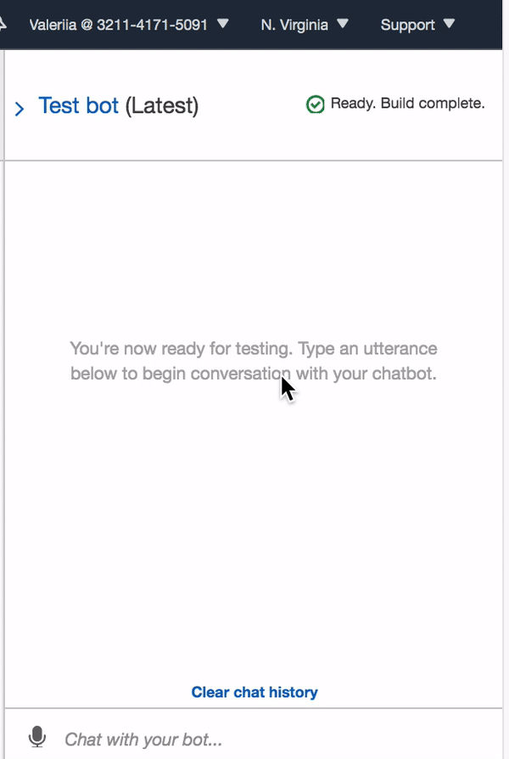

Slide 19
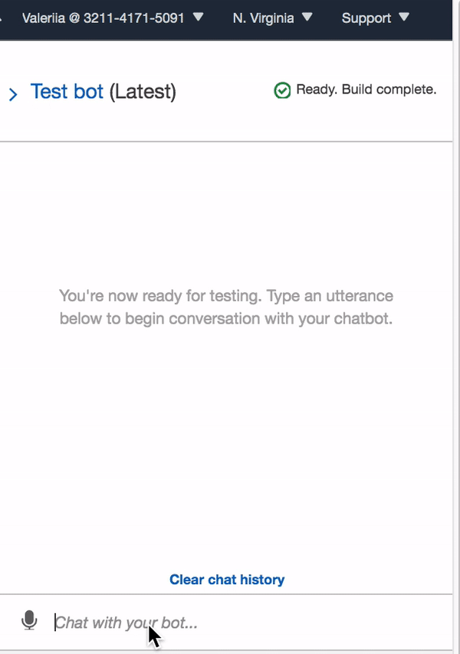

Slide 20
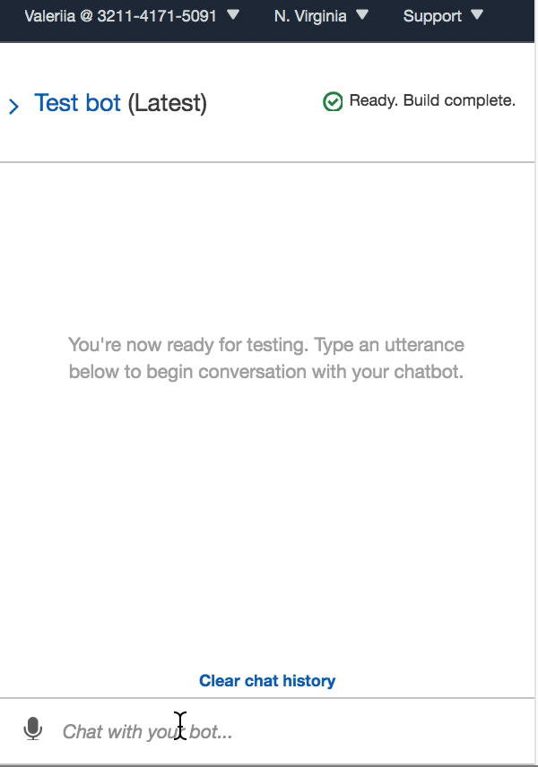

Slide 21
